Slide 1
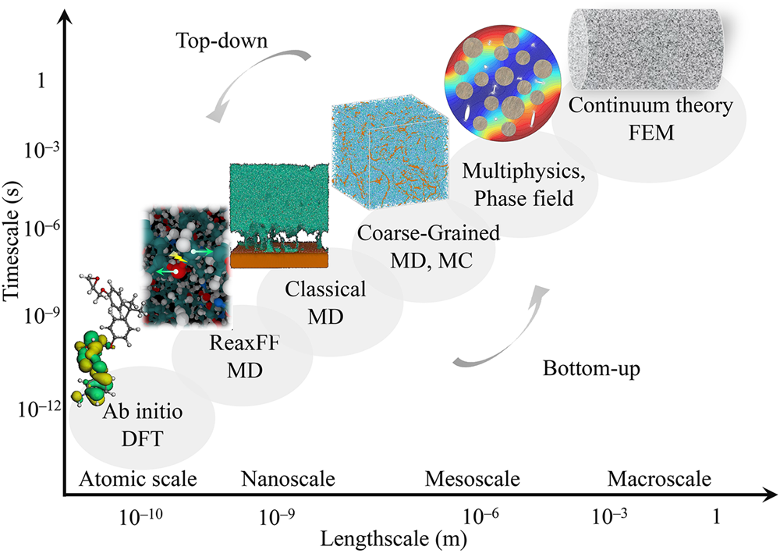
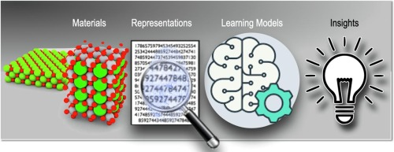
Multi-Scale Computational Approaches for Materials Property Prediction and Design
Manh Tien Nguyen

Slide 2
DFT
Catalytic piperidine +CO2
SrO and Sr(OH)2.nH2O + CO2
MD
Ionic Solvation and Transport in Zwitterionic Electrolytes
ML
Deep Learning Potential for CO2+deep eutectic solvents reactions
Finding reaction pathways
Material Design

Slide 3

A novel catalytic method for low-energy CO2 capture
Samir Budhathoki a, Manh Tien Nguyenb, Qinghua Lai c, Xuejing Kanga, Sean X. Tanga,
Zhe Chena, Kevin Jayaatmajac, Ramhari Panerua, Hertanto Adidharmac, Yuhua Duanb*,
Maohong Fan d,e*
a Department of Energy & Petroleum Engineering, University of Wyoming, Laramie, WY 82071, USA
b National Energy Technology Laboratory, United States Department of Energy, Pittsburgh, PA, 15236, USA
c Department of Chemical & Biomedical Engineering, University of Wyoming, Laramie, WY 82071, USA
d College of Engineering and Physical Science, and School of Energy Resources, University of Wyoming, Laramie,
WY, 82071, USA
eCollege of Engineering, Georgia Institute of Technology, Atlanta, GA 30332, USA

Slide 4
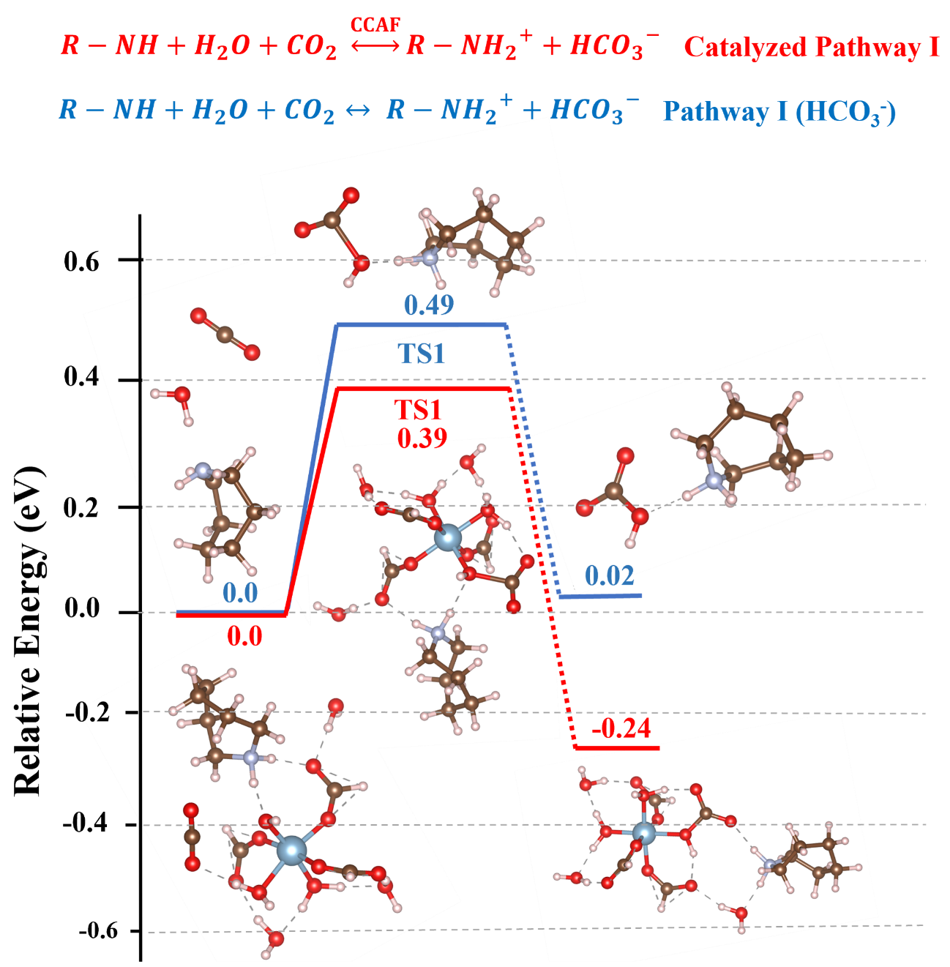
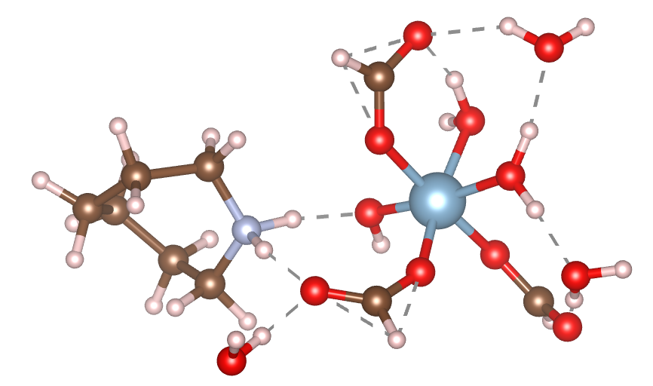
aluminum formate-water-piperidine complex
Computed profiles show that CCAF ease the reaction pathway
Single reaction pathway
Yields the formation of HCO₃⁻ and R-NH₂⁺
Free energy profiles and reaction pathways. Pathway I/Bicarbonate for catalyzed and uncatalyzed pathway II for aqueous piperidine sorbent.

Slide 5
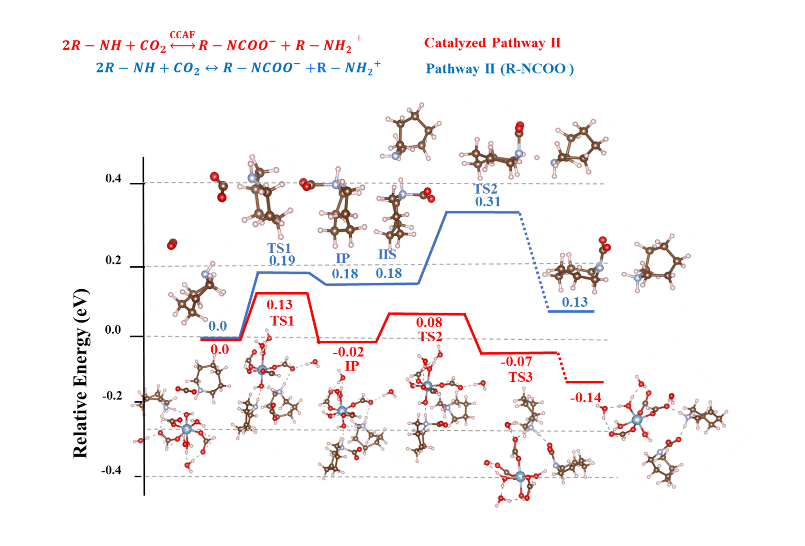
Pathway II (Zwitterion mechanism)
$R−NH+CO_{2}↔R−NH^{+}C{OO}^{−}$(Zwitterion/ZW) $(Step 1)$
$$R−NH^{+}C{OO}^{−}+R−NH↔R−NC{OO}^{−}+R−N{H2}^{+}(Step 2)$$
$R−NH+CO_{2}↔R−NC{OO}^{−}$ $+R−N{H2}^{+}$ (Overall reaction)
Free energy profiles and reaction pathways. Pathway II/ZW mechanism for catalyzed and uncatalyzed pathway II for aqueous piperidine sorbent.

Slide 6
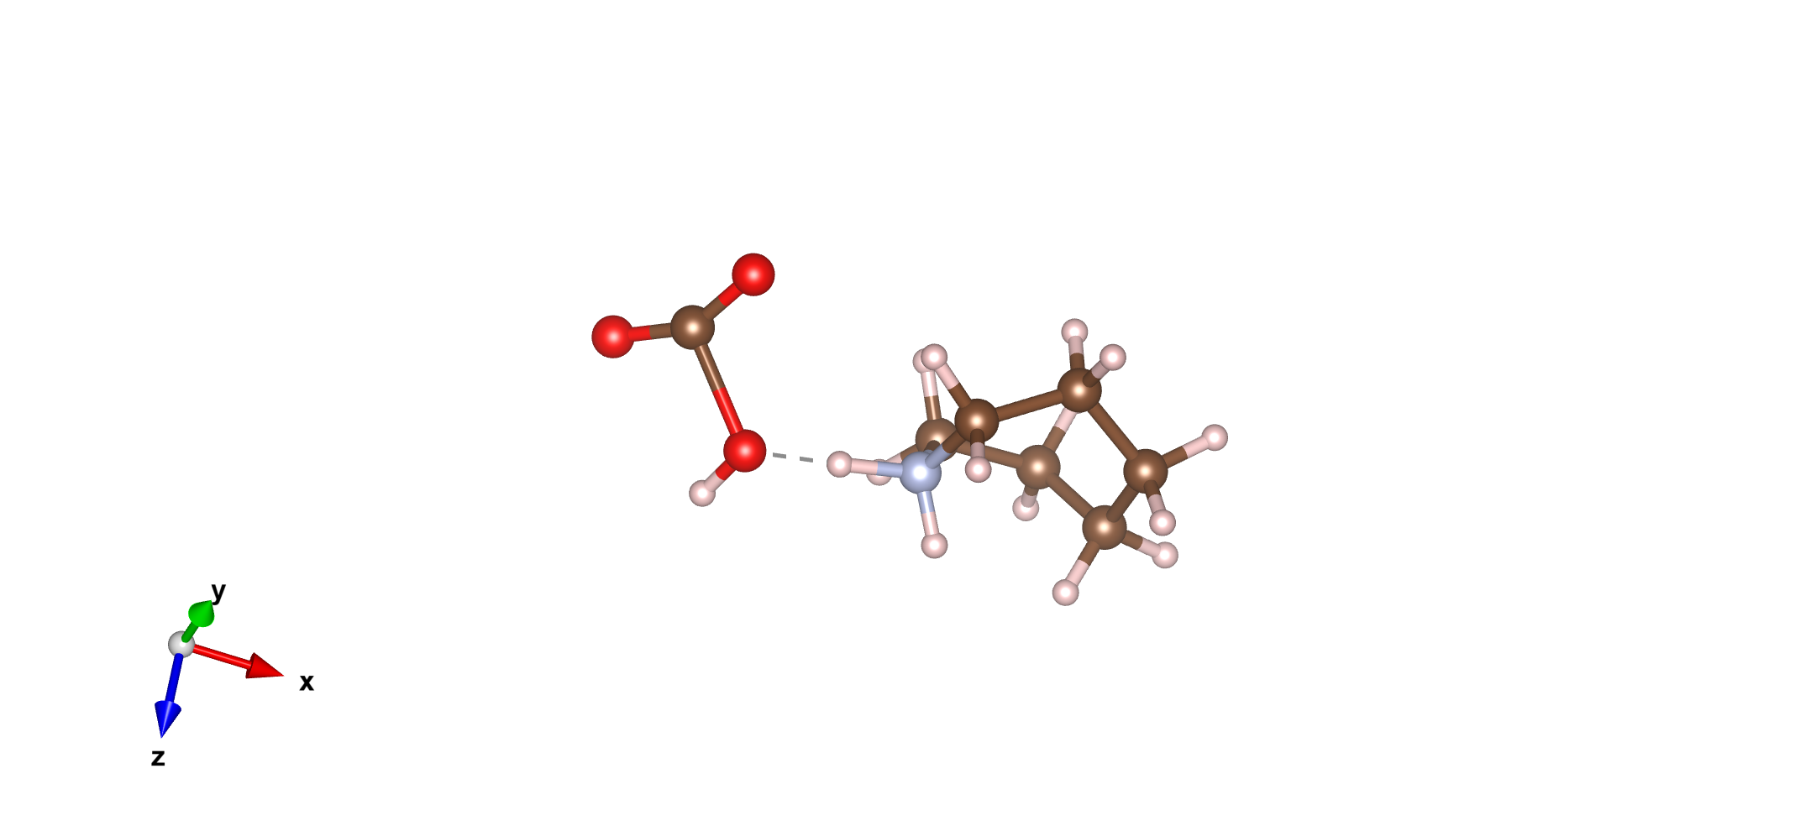
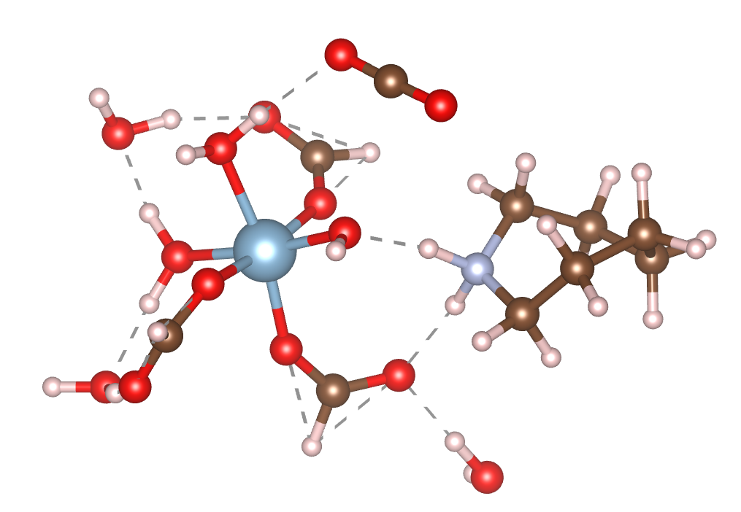
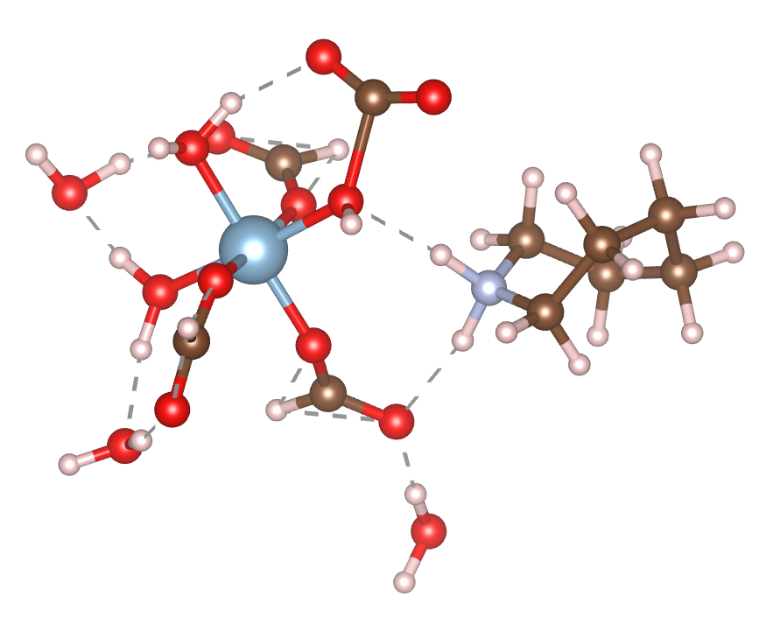
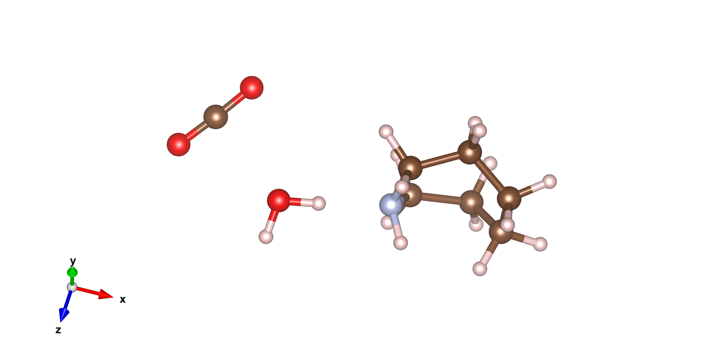
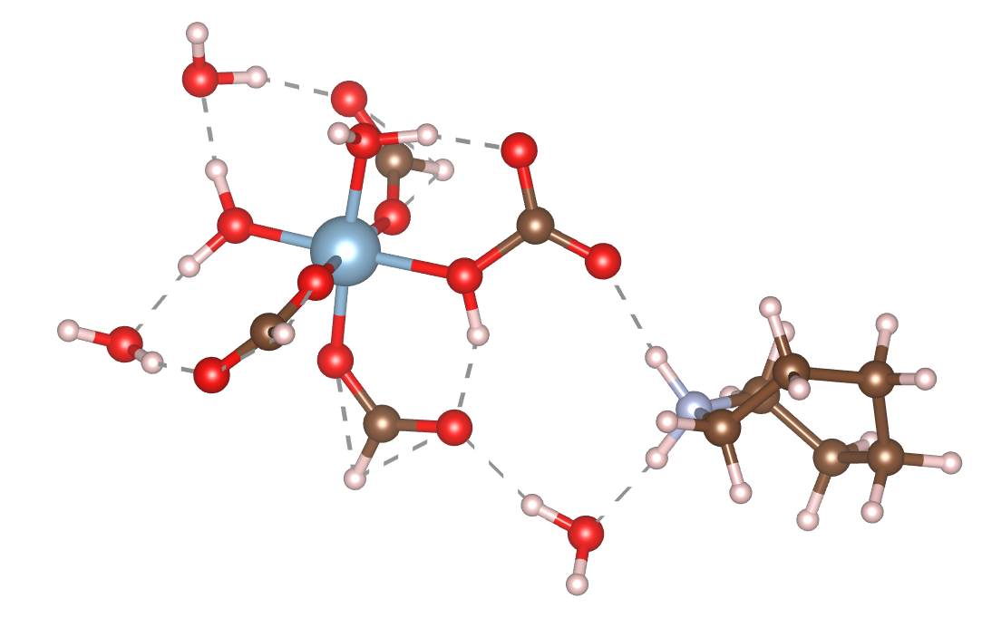
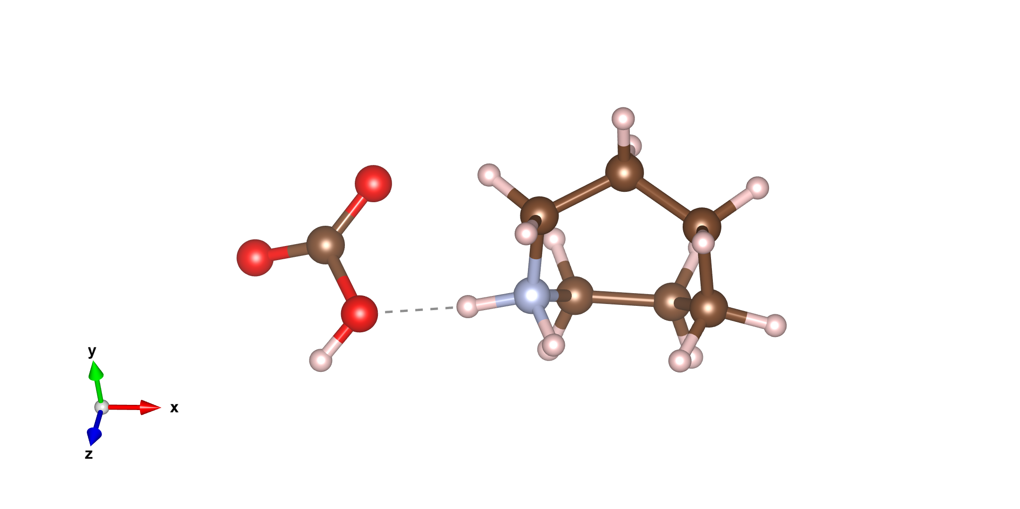
(a). Uncatalyzed pathway I (HCO₃⁻)
(b).Catalyzed Pathway I (HCO₃⁻)
(a). Step 1: CO₂ not reacted
(b). Step 2: Transition state 1
(a). Step 1: CO₂ not reacted
(b). Step 2: Transition state 1
Energy: 0.00 eV
Energy: 0.49 eV
Rxn: R-NH + CO₂ + H₂O
Energy: 0.00 eV
Energy: 0.39 eV
Rxn: HCO₃⁻ RNH₂⁺
Rxn: HCO₃⁻ RNH₂⁺ with CCAF
Rxn: R-NH + CO₂ + H₂O with CCAF
(c). Step 3: Final state
(c). Step 3: Final State
Energy: 0.02 eV
Energy: -0.24 eV
Rxn: HCO₃⁻ + RNH₂⁺
Rxn: HCO₃⁻ + RNH₂⁺ with CCAF

Slide 7
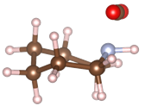
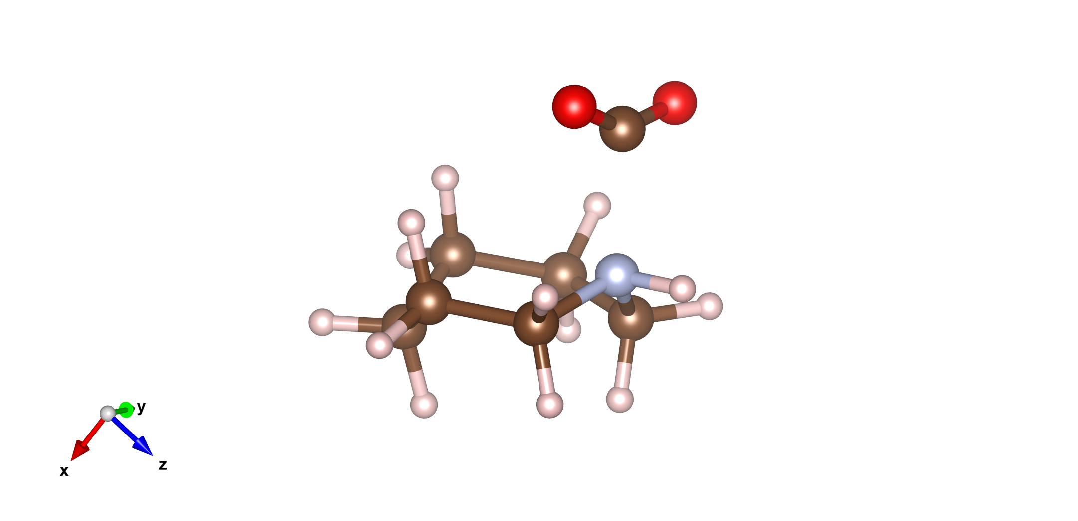
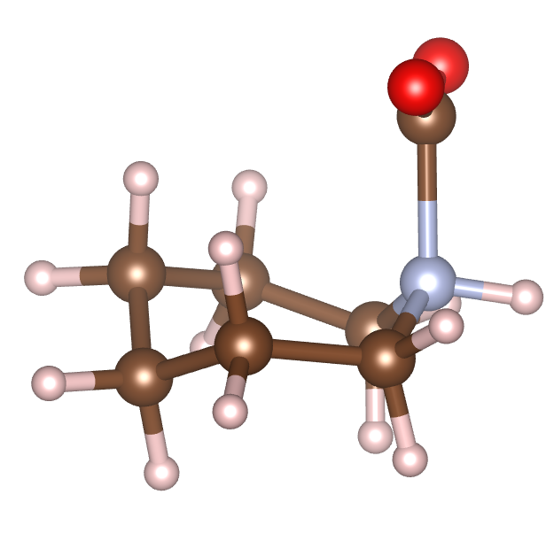
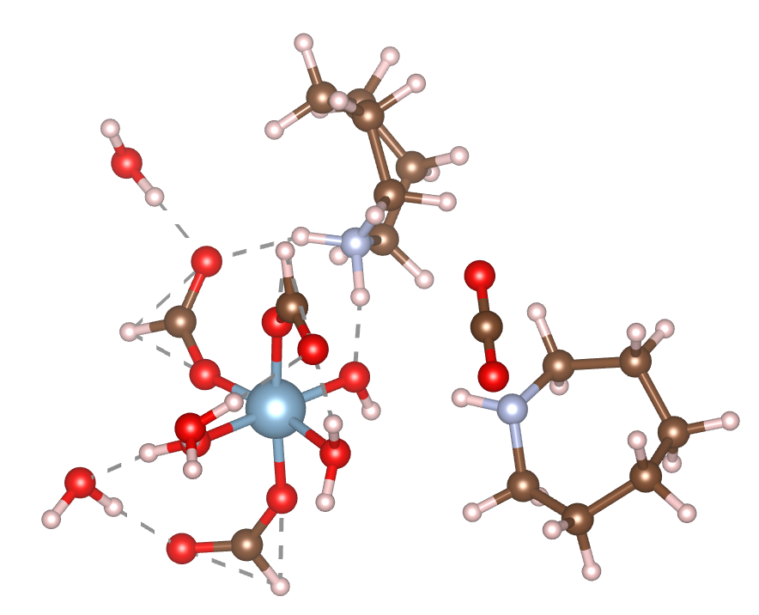
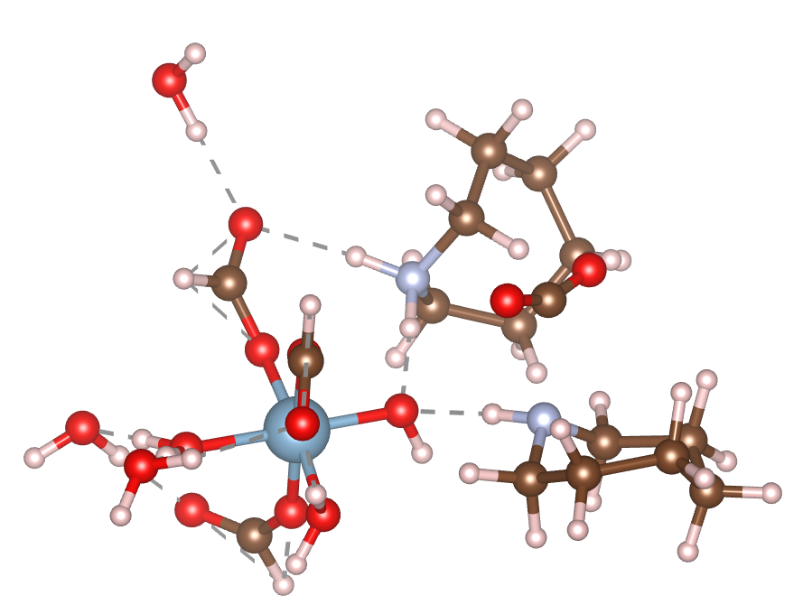
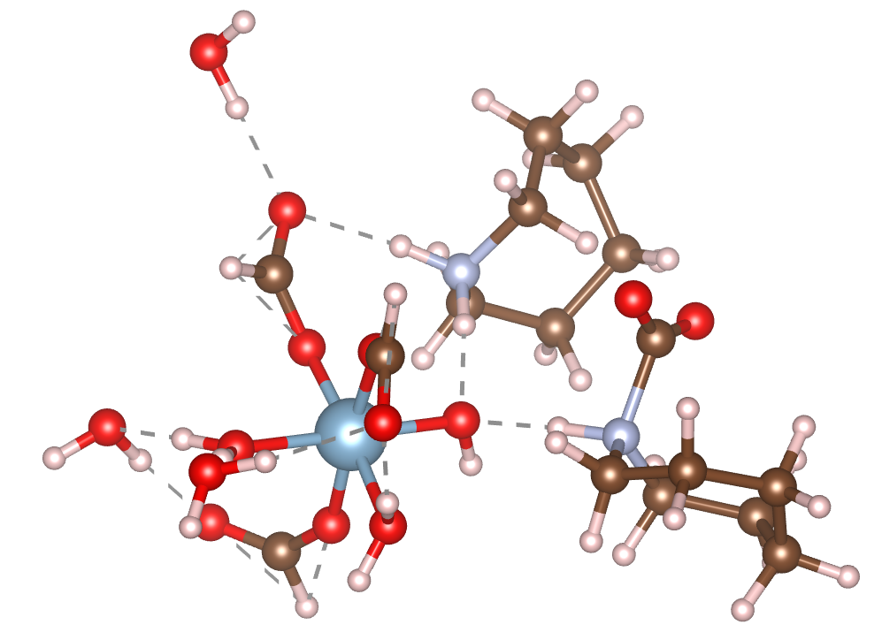
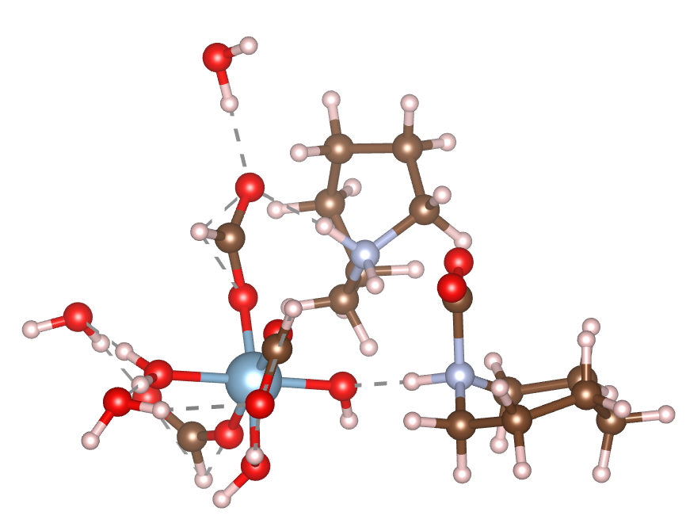
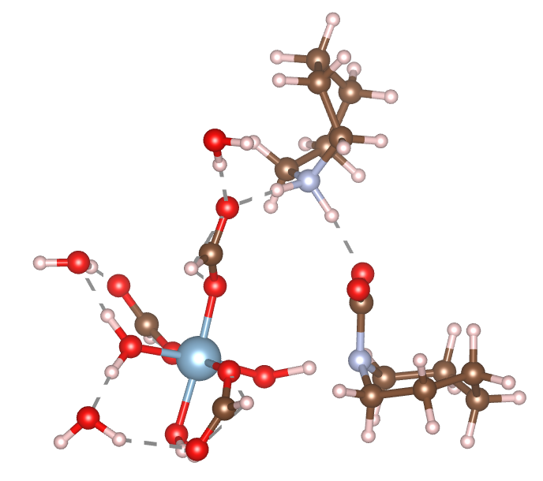
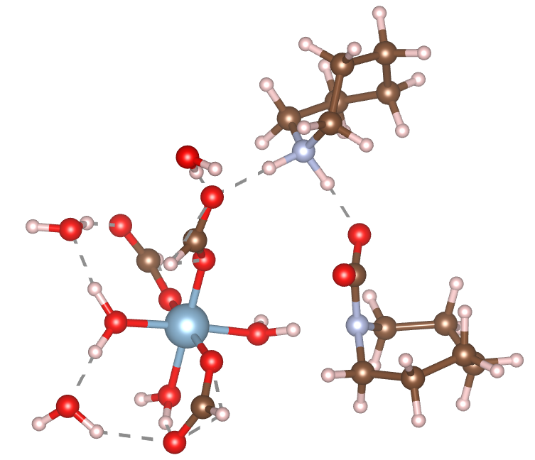
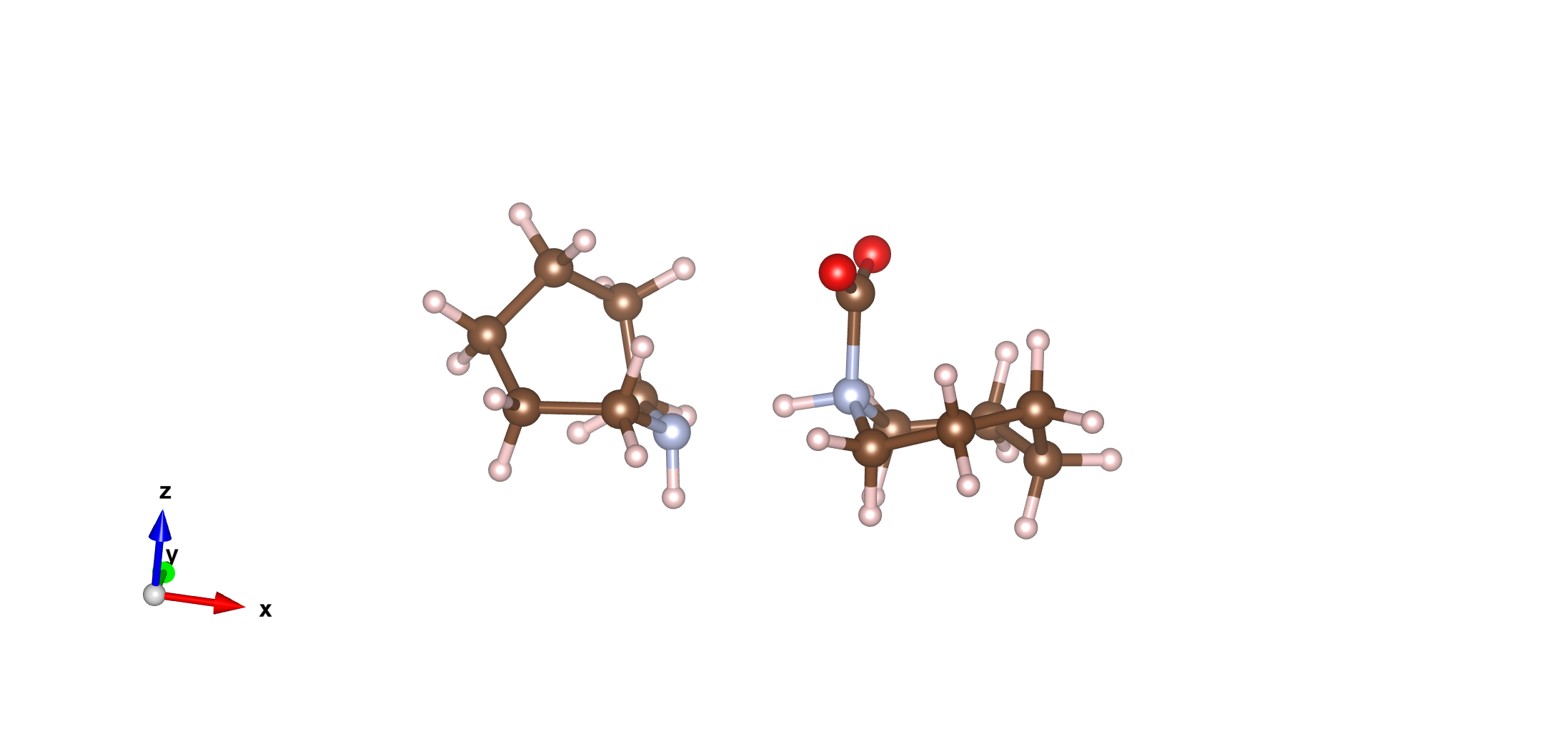
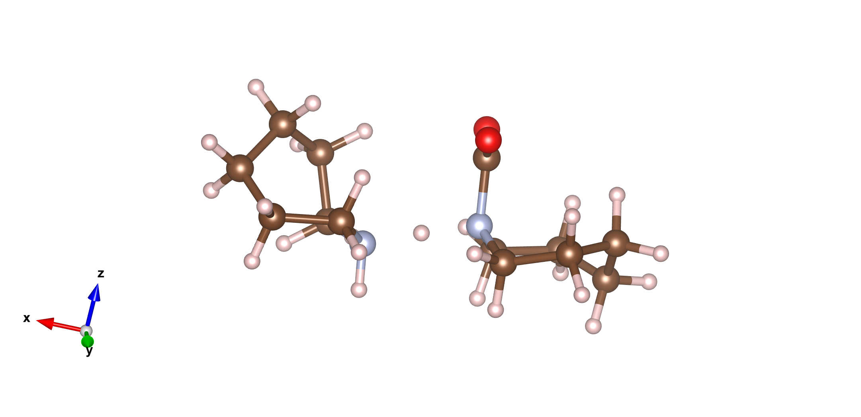
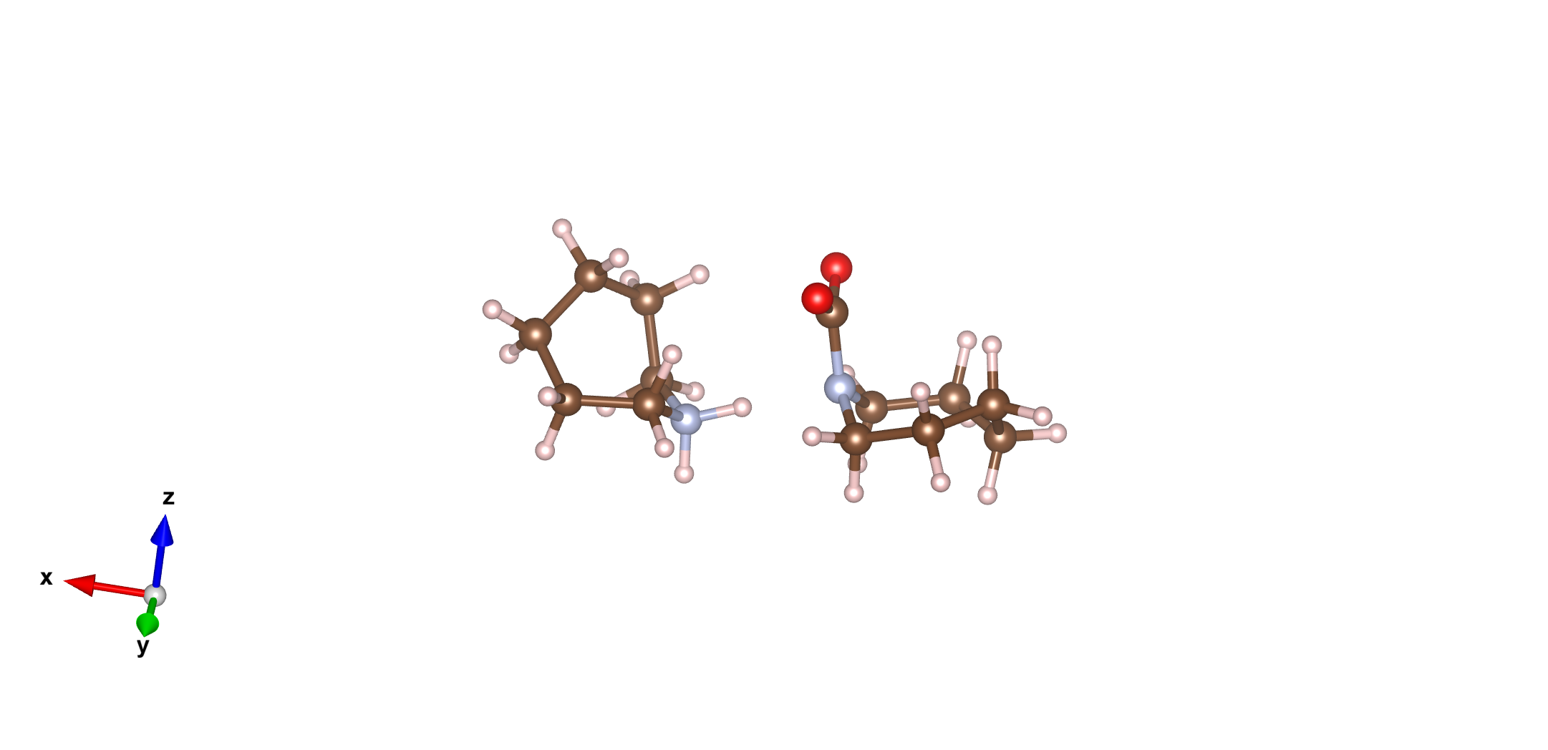
(c).Uncatalyzed Pathway II (R-NCOO⁻)
(d). Catalyzed Pathway II (R-NCOO⁻)
(a). Step 1: CO₂ not reacted
(b). Step 2: Transition state 1
(c). Step 3: Intermediate product
(a). Step 1: CO₂ not reacted
(b). Step 2: Transition state 1
(c). Step 3: Intermediate product
Energy: 0.00 eV
Energy: 0.19 eV
Energy: 0.18 eV
Energy: 0.00 eV
Energy: 0.13 eV
Energy: -0.02 eV
Rxn: R-NH + CO₂
Rxn: R-NH⁺-CO₂
Rxn: R-NH⁺COO⁻
Rxn: 2R-NH + CO₂ with CCAF
Rxn: R-NH⁺-CO₂ + R-NH with CCAF
Rxn: R-NH⁺COO⁻ + R-NH with CCAF
(d). Transition state 2
(e). Transition state 3
(f). Step 6: Final state
(d). Step 4: Initial intermediate product
(e). Step 5: Transition state 2
(f). Step 6: Final state
Energy: 0.18 eV
Energy: 0.31 eV
Energy: 0.13 eV
Energy: 0.08 eV
Energy: -0.07 eV
Energy: -0.14 eV
Rxn: R-NH⁺COO⁻ R-NH
Rxn: R-NCOO⁻ R-NH₂⁺
Rxn: R-NCOO⁻ + RNH₂⁺
Rxn: R-NH⁺COO⁻ R-NH with CCAF
Rxn: R-NCOO⁻ R-NH₂⁺ with CCAF
Rxn: R-NCOO⁻ + RNH₂⁺ with CCAF

Slide 8
Theoretical study of CO₂ capture mechanisms of SrO and Sr(OH)₂.nH₂O (n=0,1,8)
Manh Tien Nguyen, Dominic Alfonso, Christopher M. Marin, Douglas Kauffman, Yuhua Duan
National Energy Technology Lab

Slide 9
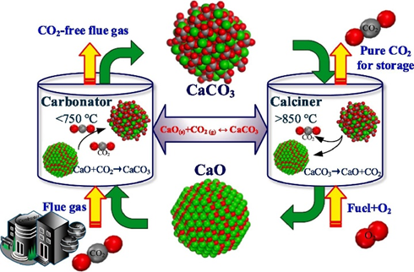
CO₂ Capture using SrO
Reactive capture uses metal oxides and solid carbon to capture/convert CO₂
Capture: Thermally heating a mixture of CO₂ and metal oxide forms a stable metal carbonate:
CO₂ + MO → MCO₃
Conversion: Subsequently heating the MCO₃ and solid carbon produces carbon monoxide and regenerates the sorbent
1. MCO₃ + C → 2CO + MO (commercially useful)
2. MCO₃ → CO₂ + MO
CaO has been used due to relatively low-cost and abundance
SrCO₃/SrO showed much better CO selectivity than CaCO₃/CaO
Wang, N., Feng, Y., & Guo, X. (2020). Applied Surface Science, 532, 147425.
9
Notes:
Wang, N., Feng, Y., & Guo, X. (2020). Atomistic mechanisms study of the carbonation reaction of CaO for high-temperature CO2 capture. Applied Surface Science, 532, 147425.

Slide 10
CO₂ Adsorption and Desorption on Surfaces
SrO can react with H₂O in flue gas to form Sr(OH)₂.nH₂O
CO₂ adsorption first happens on the surface before CO₂ diffuses into the bulk
H₂O
H₂O
7H₂O
SrO
Sr(OH)₂
Sr(OH)₂.1H₂O
Sr(OH)₂.8H₂O
CO₂
CO₂
CO₂
CO₂
SrCO₃
10

Slide 11
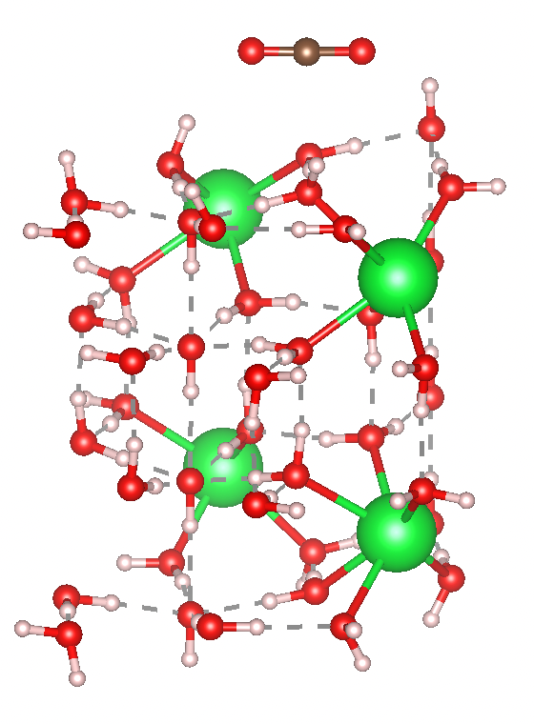
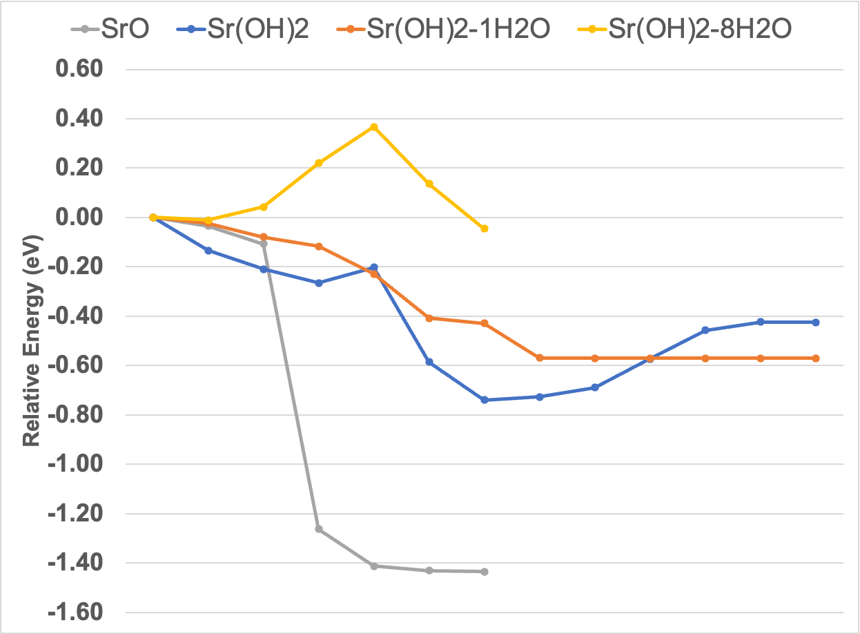
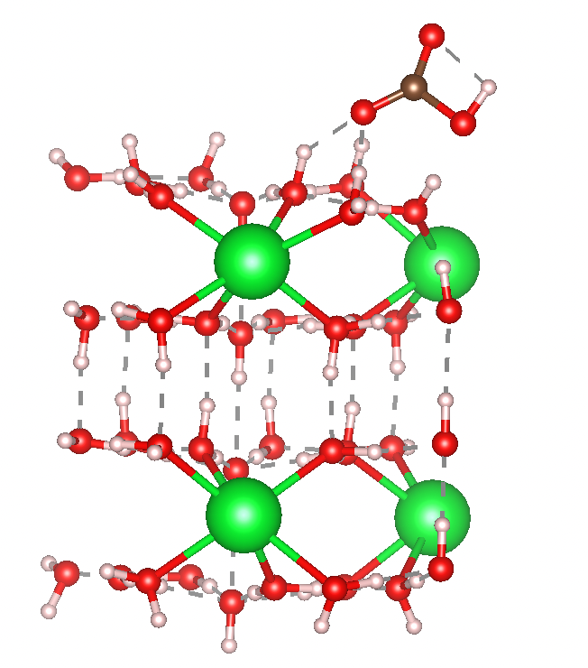
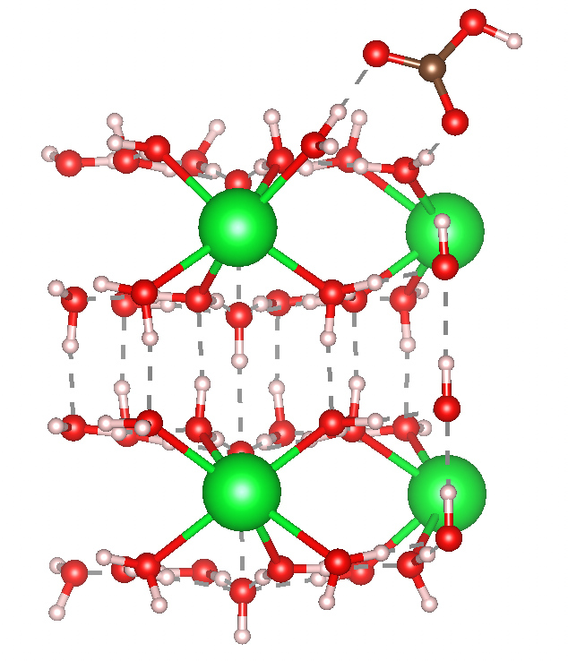
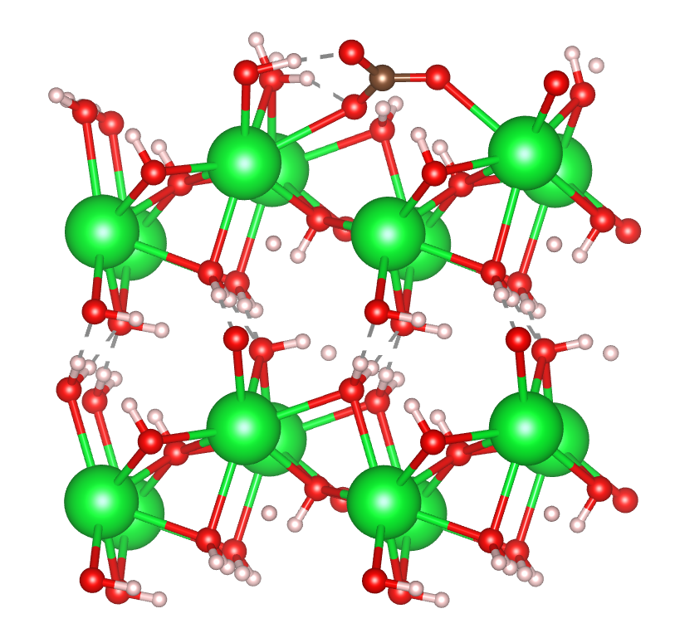
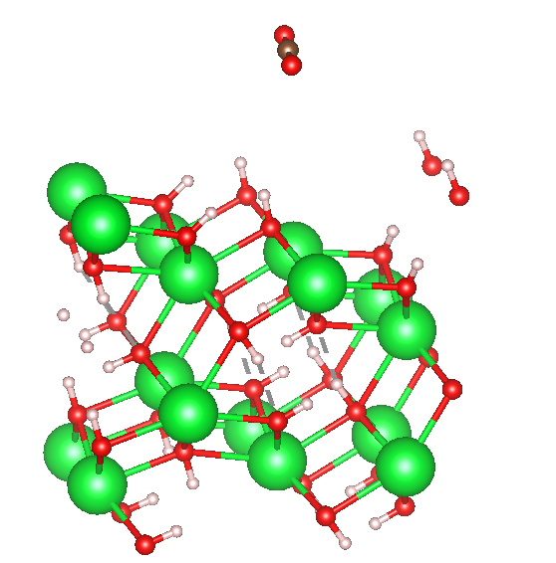
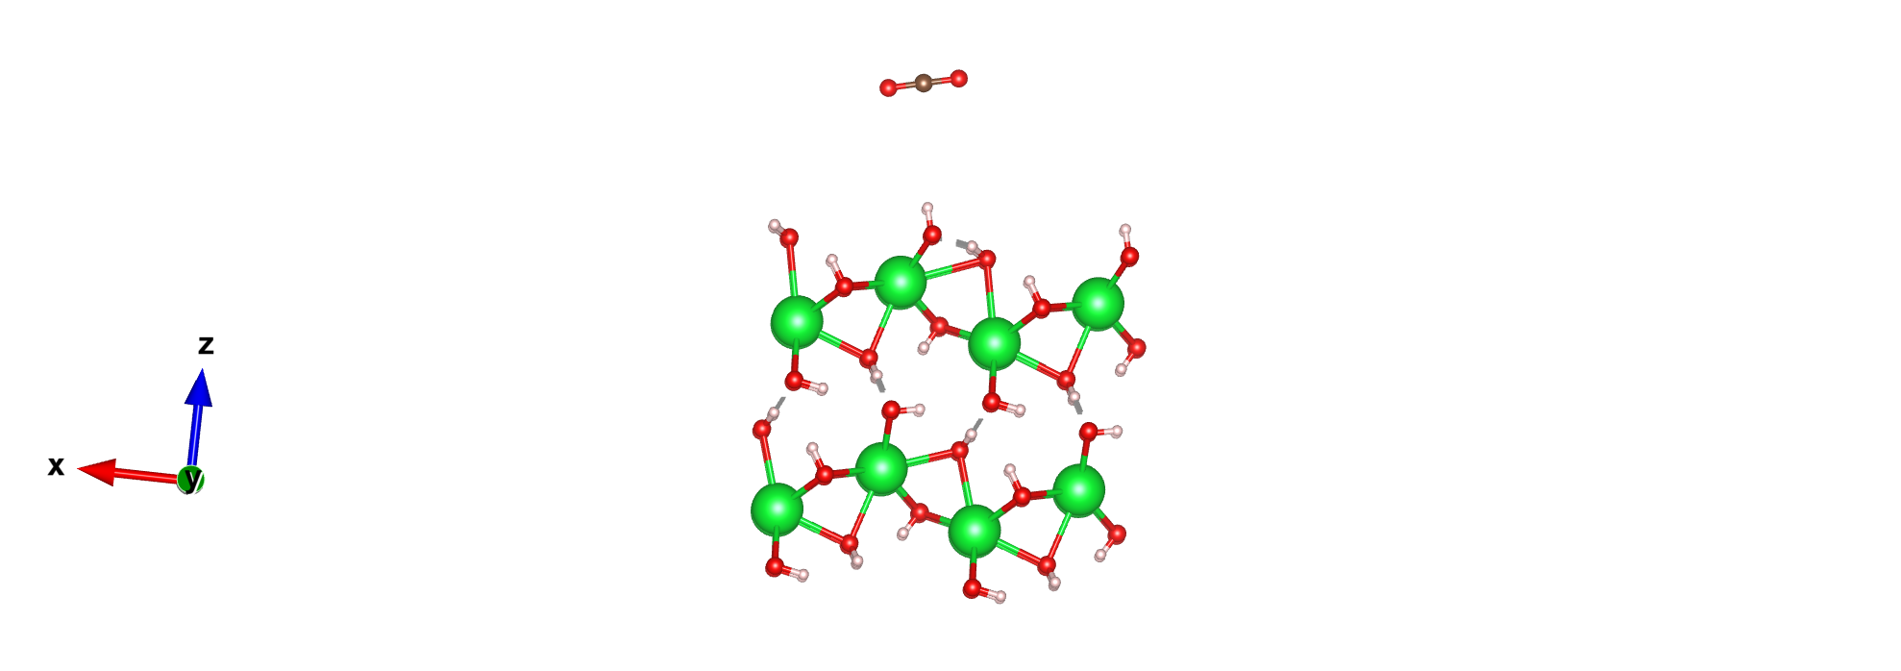
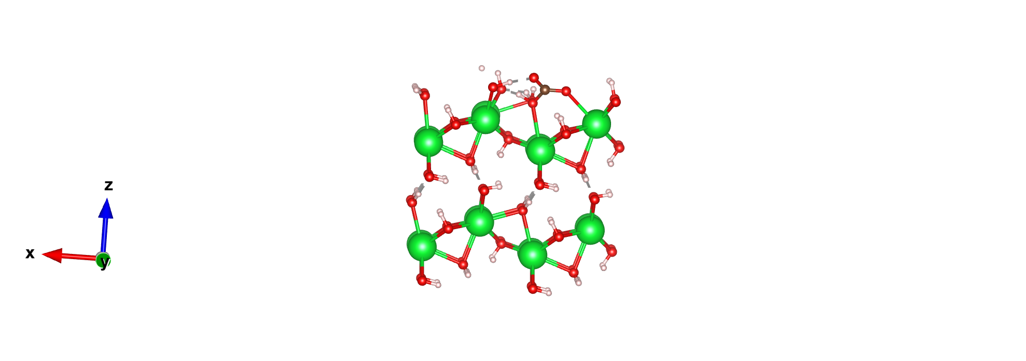
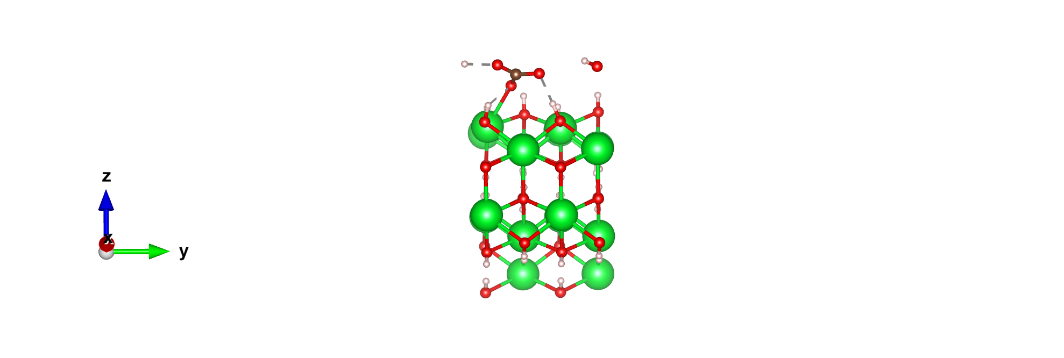
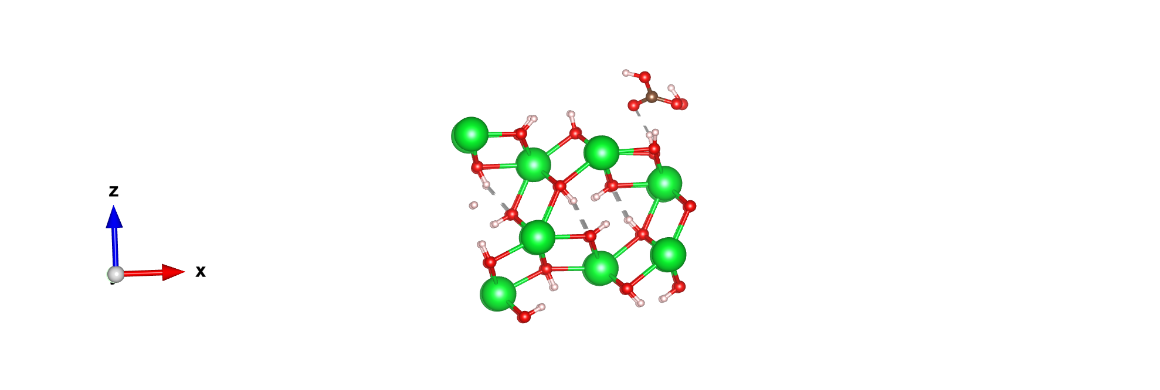
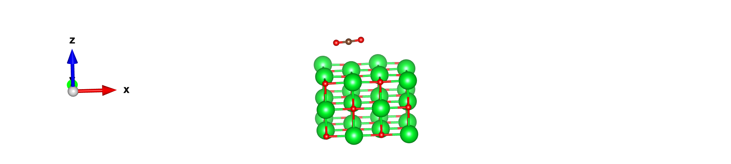
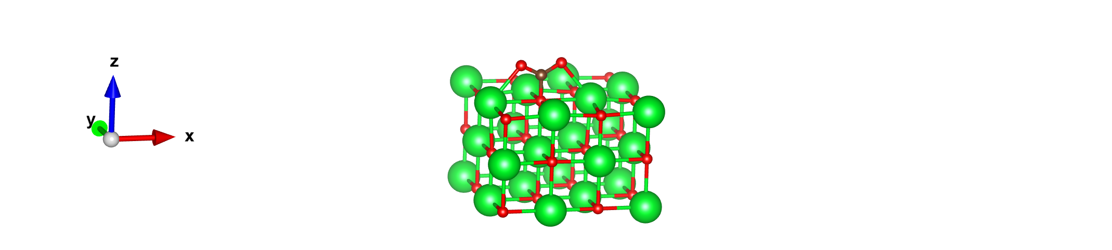
CO₂ adsorption reaction pathways
Bicarbonate
carbonate
Carbonate
11
Relative energies of CO₂ capture reaction

Slide 12
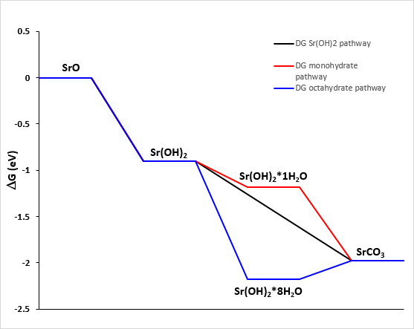
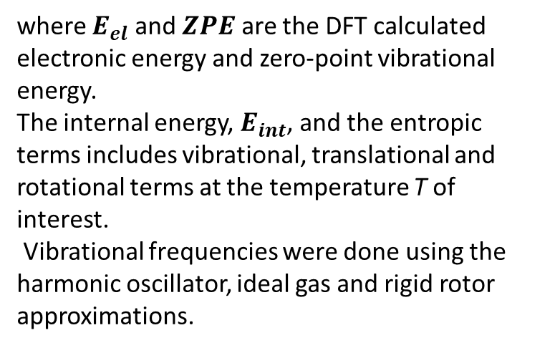
CO₂ reaction thermodynamics
$G_{gas}=E_{el}+E_{int}+ ZPE−\left(S_{v}+S_{t}+S_{r}\right)T+PV$
where $E_{el}$ and $ZPE$ are the DFT calculated electronic energy and zero-point vibrational energy.
The internal energy, $E_{int}$, and the entropic terms includes vibrational, translational and rotational terms at the temperature T of interest.
Vibrational frequencies were done using the harmonic oscillator, ideal gas and rigid rotor approximations.
12

Slide 13
Molecular Dynamics for ionic transport and solvation in electrolytes

Slide 14
Zwitterionic Effect on
Ionic Solvation and Transport in Electrolytes
Manh Tien Nguyen
Qing Shao
Department of Chemical and Materials Engineering
University of Kentucky

Slide 15
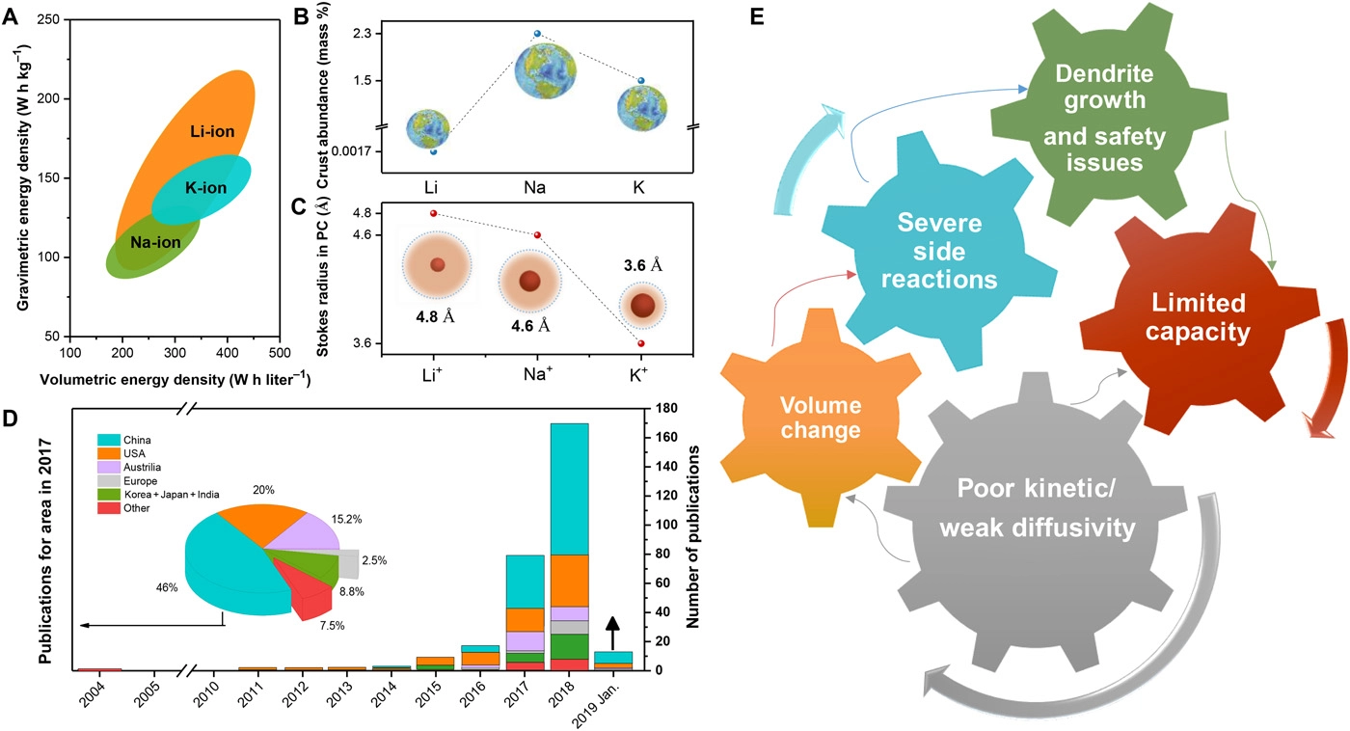
Safer batteries with solid-state electrolytes
Li⁺ battery is critical for sustainable future
Na⁺ and K⁺ are alternatives to Li⁺ batteries due to their abundance and low-cost﻿
Flammable liquid electrolytes have safety issues: leakage and short-circuit One solution: Develop solid-state electrolytes with high ionic conductivity
Challenge: Need to enhance Li⁺, Na⁺ and K⁺ kinetics/diffusion in solid-state electrolytes
https://www.targray.com/li-ion-battery/electrolyte
Zhang et al. Science advances 5.5 (2019)
SHAWN L. MINTER/AP
http://www.youtube.com/user/ajgill206rr?feature=watch

Slide 16
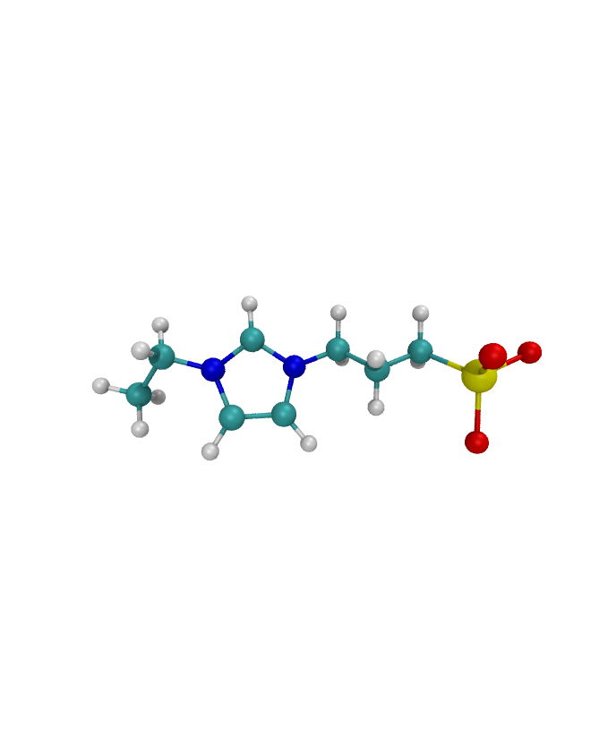
Zwitterionic Electrolytes
Li⁺
Anion⁻
ZW molecules possess both cationic and anionic groups
They can associate with both Li⁺ and anion and themselves
We can leverage this ability to increase ionic conductivity of solid polymer electrolytes
ZW-
ZW+
H
N
O
N
C
S
Zwitterion (ZW)

Slide 17
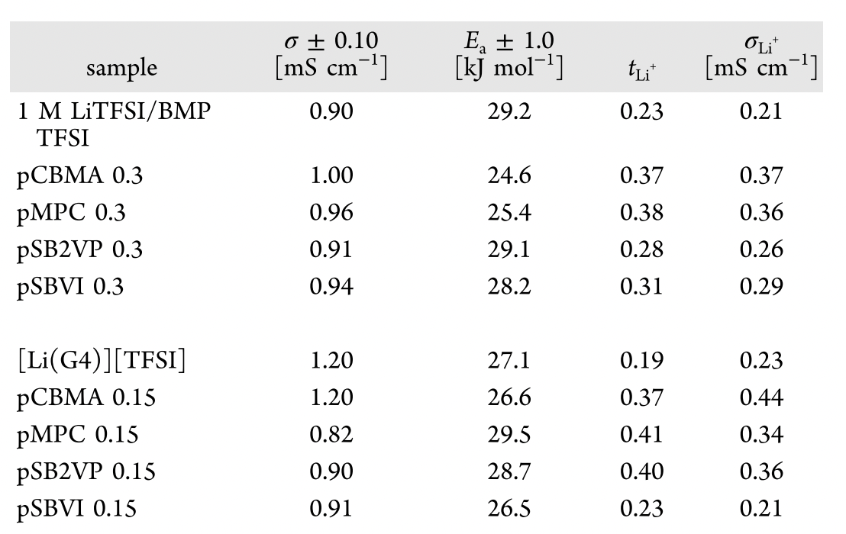
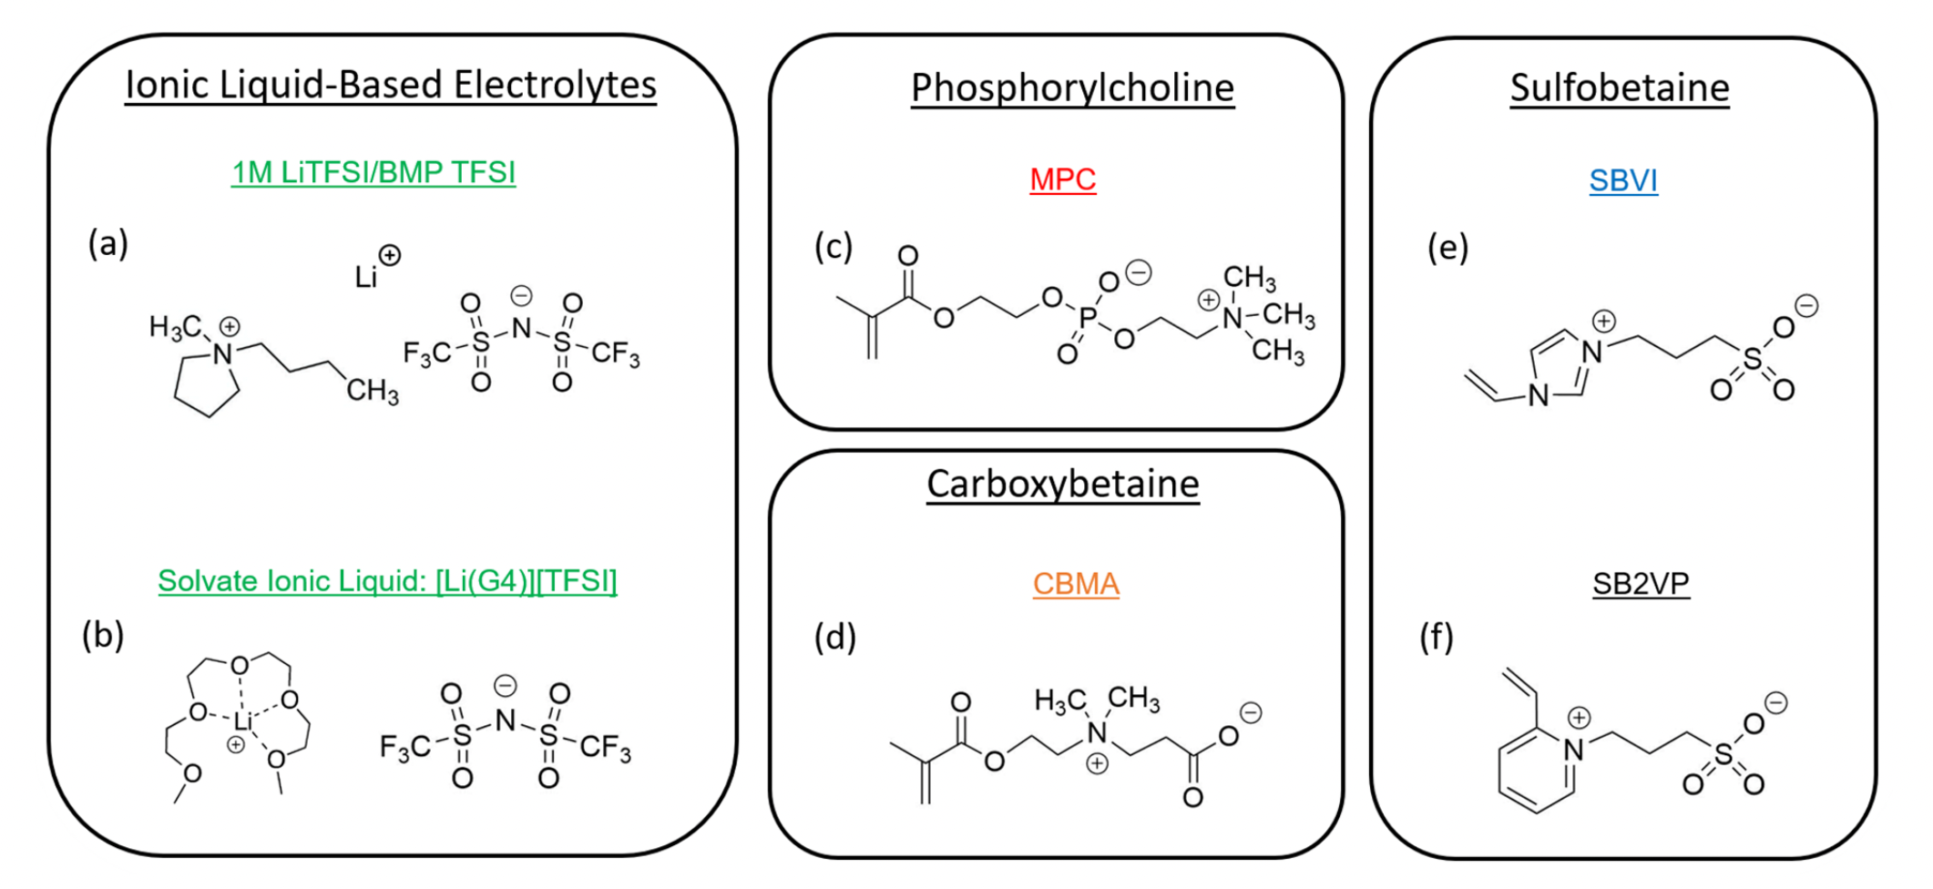
Zwitterionic Electrolytes
Jones et al. ACS central science 8.2 (2022)
Poly(ZW) scaffold can enhance the target ion transport

Slide 18
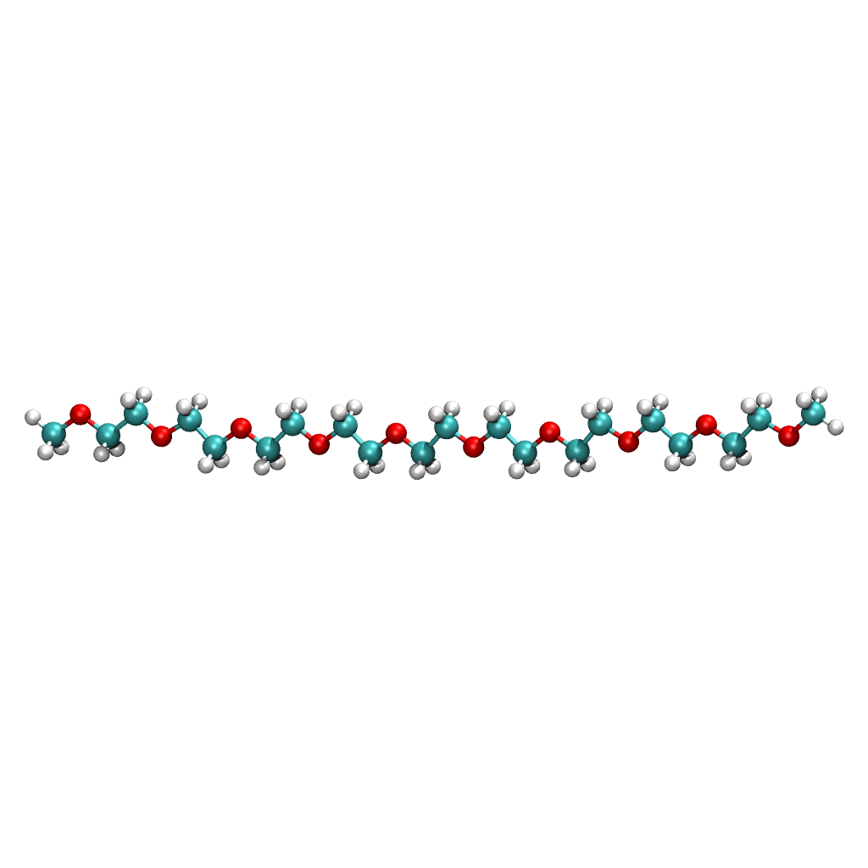
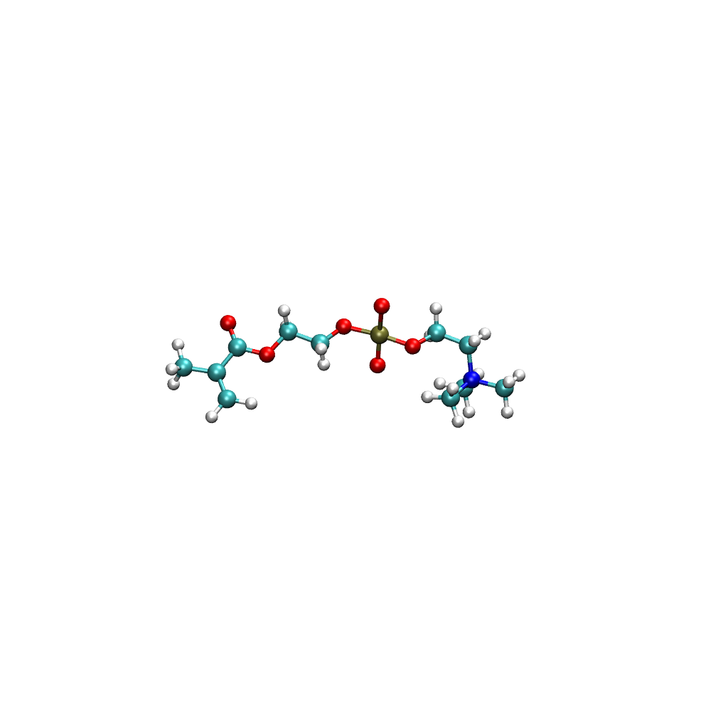
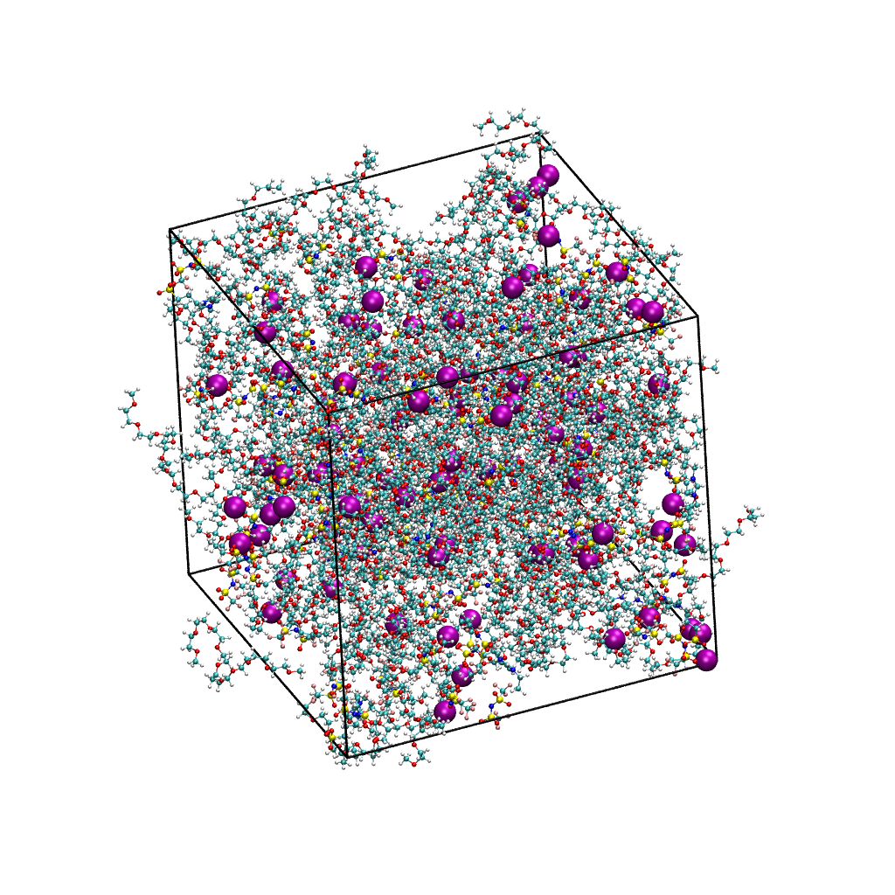
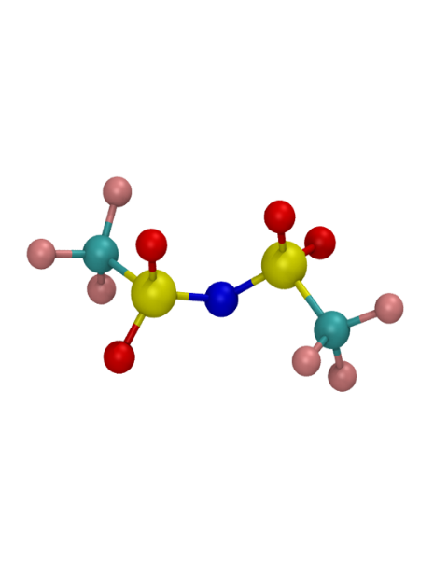
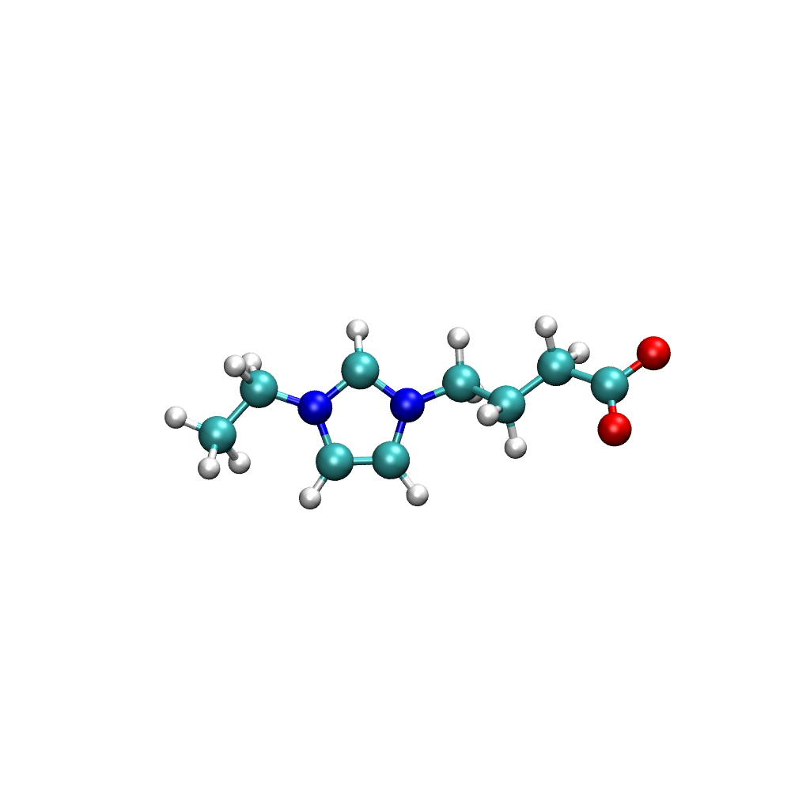
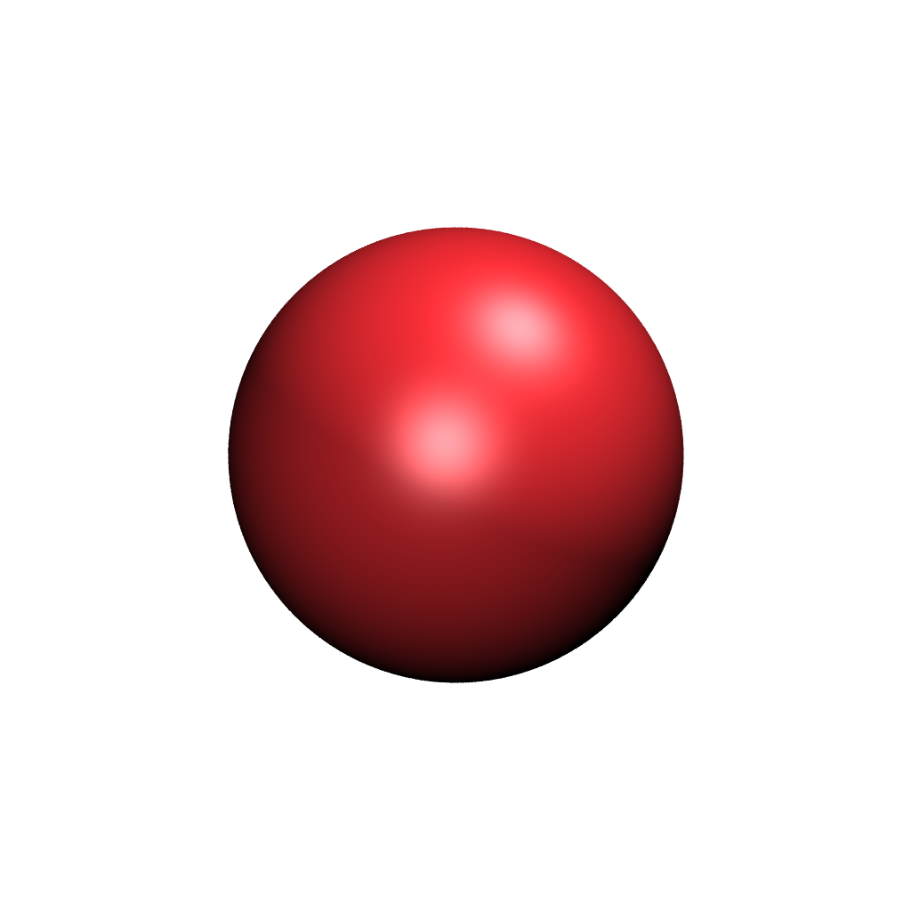
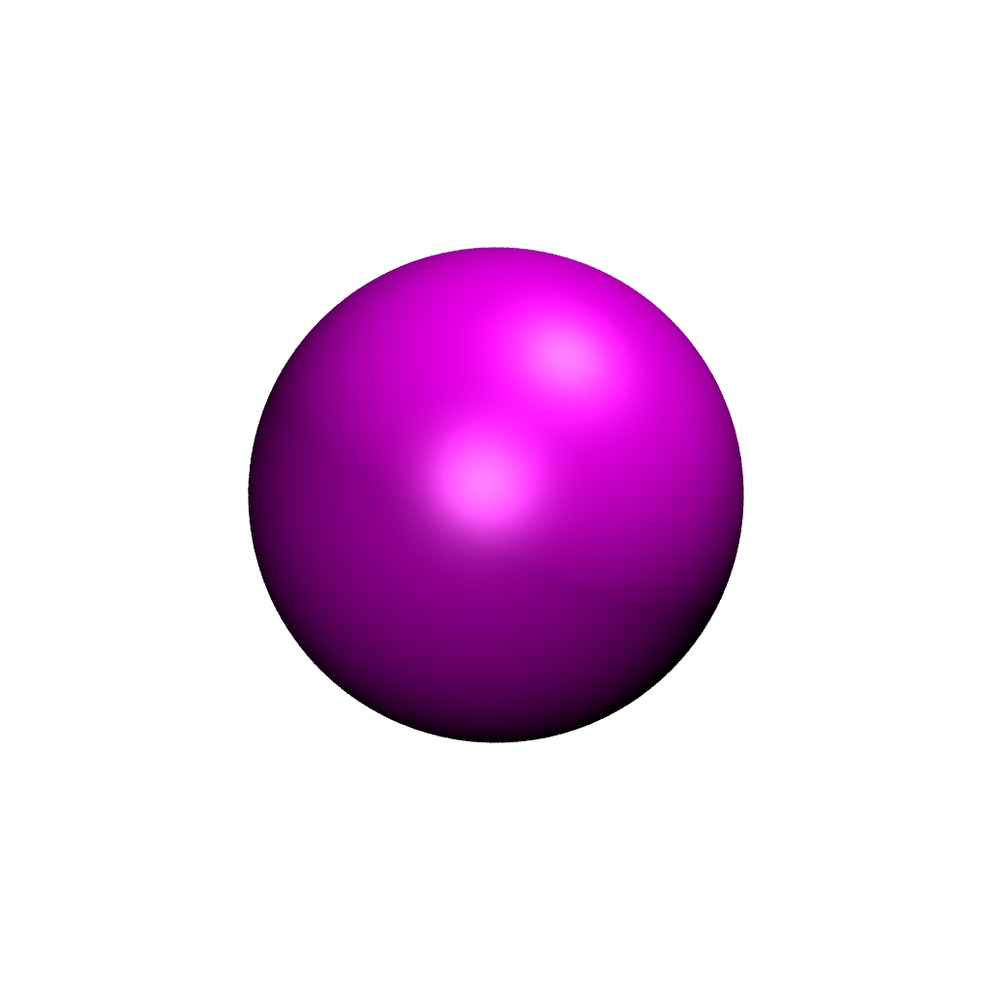
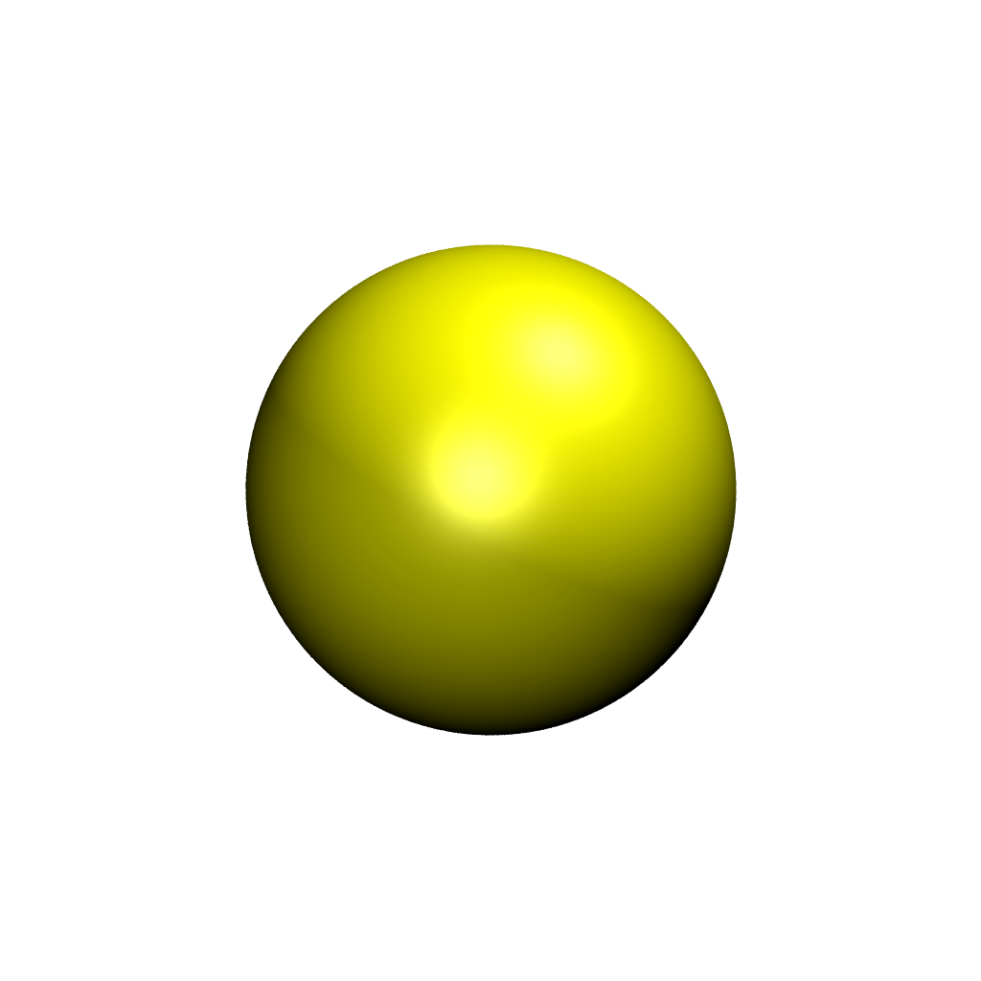
Molecular Dynamics Simulation
3 ZW Structures
O
P
EO₁₀
(ethylene oxide)10
N
MPC
2-methacryloyloxyethyl phosphorylcholine
F
C
O
N
S
N
N
C
TFSI⁻
bis(trifluoromethylsulfonyl)-imide
O
CB
carboxybetaine ethylimidazole
N
H
N
O
S
Na⁺
K⁺
Li⁺
SB
sulfobetaine ethylimidazole

Slide 19


Ionic Dissociation Effect of ZW in PEO
ZW free Li⁺ from trapping effect of poly(ethylene oxide)
ZW could also trap Li⁺ and slow down its transport

Slide 20
ZW structures and surface charge density
MPC (-PO₄)
SB (-SO₃)
CB (-CO₂)
Charge density:
CB > MPC > SB
Electronegativity:
MPC > SB >CB
A sigma profile is the probability distribution of a molecular surface segment having a specific charge density
The electronegativity of a molecule can be quantified by the area of σ>=0.01 e/Å² region

Slide 21
EO₁₀
ZW Dissociation Effect
MPC (-PO₄)
SB (-SO₃)
CB (-CO₂)
K⁺
Li⁺
Na⁺
Percentage of cations not associating with EO₁₀
MPC > CB > SB in releasing cations from association with EO₁₀
The effect MPC is weakened from Li⁺ to K⁺

Slide 22

ZW Effect on Cationic Diffusion
Ratios of cationic diffusion coefficients: With vs without ZW
All ZW slow down cationic diffusions of K⁺ while only SB does for Li⁺ and Na⁺
ZW can have the dissociation effect without reducing diffusion for Li⁺ and Na⁺

Slide 23
Deep Learning Potential For Investigation of Chemical Conversion of CO₂ at Air-Reactive Deep Eutectic Solvent Interface
Manh Tien Nguyen (Tien)
Mentors: Qing Shao*, Yueh-Lin Lee** & Yuhua Duan**
*University of Kentucky
**National Energy Technology Lab
Notes:
#1: Hello everyone. My name is Tien. I’m a phd candidate from University of Kentucky. Today I’m presenting my internship project at NETL under the mentorship of Dr. yuehlin Lee and Dr. yuhua Duan.
The project is about “Quantum computing of vibrational properties for CO2 capture application

Slide 24


Deep Eutectic Solvents for CO₂ Capture
Carbon capture is necessary to reduce CO₂ emissions from burning fossil fuels, which has led to global warming
Traditional CO2 capture by aqueous amine has drawbacks such as high energy consumption, equipment corrosion, and toxic leakage to the environment.
Deep eutectic solvents (DESs) are promising due to their low vapor pressure, low corrosion, non- toxicity, relatively low cost, and biodegradable nature.
Dmitry Kovalchuk/Shutterstock.com
Notes:
#5: CO2 is captured by reactions with amine-based solventto reduce emission from burning fosil fuels and help solve the grobal warming. to simplify the calculation, We use NH3 as model solvent. The reaction is as followed: NH3 reacts to CO2 resulting in NH2COOH.

Slide 25







Reactive DES for Direct Air Capture
CNPC
EMIC
CNP: 2-cyanopyrrolide
CNPC: carbamate
Reactive DES can capture CO2 at low partial pressure (410ppm)
EMI: 1-ethyl-3-methylimidazolium
EMIC: carboxylate
EGC
Product Distribution
EG: ethylene glycol
EGC: carbonate
Lee et al. ACS Sustainable Chemistry and Engineering. 2021, 9(3), 1090-1098

Slide 26

Machine Learning Potential
Friederich, Pascal, et al. "Machine-learned potentials for next-generation matter simulations." Nature Materials 20.6 (2021): 750-761.
Machine learning potentials allow simulation of complex CO₂ capture reactions at solvent-air interface with solvation effect

Slide 27

Deep Learning Potential Development
Train and validate model
Construct database
DPMD simulations
27

Slide 28



Construct Database
Initial configurations
[EMI][CNP]:EG = 1:2 (6 EMI, 6 CNP and 12 EG molecules)
Adding 1, 5, and 10 CO₂ molecules, 1, 5 reaction products (CNPC, EMIC, EGC)
Interface: ~2x2x2 nm slab of DES with 2 nm thick vacuum on both sides.
Classical molecular dynamics using OPLS-AA force field to generate initial configurations
Ab-initio simulations at 300-1000K and well-tempered meta-dynamics to collect more configurations
Get potential energy and atomic forces for collected structures at DFT level of theory ﻿(molopt-DZVP basis set and GTH pseudopotential)
Bulk
Interface

Slide 29


Train and Validate Deep Potential Model
Active Learning Scheme
z
Energy
Force
Atomic environment descriptor: 8 Å radius, smooth-edition, angular-radial descriptors
DP neural networks: 3 layers of 600x600x600 ﻿neurons.
DP model with the best performance will be selected to run DPMD simulations.
Xu, Nan, et al. The Journal of Physical Chemistry C124.30 (2020): 16278-16288.
29

Slide 30

Train and Validate Deep Potential Model
Dataset size | Bulk | Interface
Initial configs from MD and AIMD | 17310 | 5157
Active learning explored | 18893 | 13139
Optimize weights and biases by ﻿the stochastic gradient descent method for minimizing atomic energy and force ﻿errors.
Final model with energy error of 2 meV/atom and force error of 0.3 eV/Å
500k iteration step can reduce force error to ~0.1 eV/Å
Force and energy errors after 100k steps
30

Slide 31

Deep Potential Molecular Dynamics
Run well-tempered metadynamics simulations with the Deep Potential at 300K.
The free energy surfaces (FESs) are constructed for the bonding distance of CO₂ and three DES components: CNPC, EMIC and EGC
Bulk
CNPC
EMIC
EGC
Interface
31

Slide 32


Deep Potential Molecular Dynamics
Proton transfer observations
From EG to EG
From EG to CNP
32

Slide 33












Deep Potential Molecular Dynamics
CNPC
EGC
EMIC
33

Slide 34


Deep Potential Molecular Dynamics
Free Energy Surface
In Bulk
In Interface
CNP-CO₂ has the lowest stability: the least product yield
The energy barrier: EMI-CO₂ > EG-CO₂ : EGC is the most yielded product
EGC is more stable in bulk than in the interface while EMIC is the opposite
34

Slide 35

ML pipeline for perovskites materials discovery
For advanced real-time monitoring and control of gas species in combustion environments, development of efficient sensing platforms and new sensor materials able to work under harsh environments are required.
Semiconducting optical-based sensor platforms show promise. MO_{x} metal-oxides and ABO₃ perovskite-oxides can be attractive for high-temperature applications due to their high decomposition temperatures and structural stability; ABO₃ allows tunable electronic and optical properties owing to flexible choices of A, B dopants and forming oxygen non-stoichiometric point-defects
Machine learning (ML) approach from first-principles modeling to calculate band gap in addition to extreme gradient (XG) boosting regression to predict perovskite conductivity with the intention to generate sensor candidates.

Slide 36

ML-driven discovery pipeline
Exploring the vast compositional space of ABO₃ perovskites by selecting 1-2 elements from 13 options for the A-site and 1-2 elements from 36 options for the B-site, creating around 187 million initial combinations.
A site | Ba | Bi | Ca | Ce | Gd | La | Mg | Nd | Pr | Sm | Sr | Y | Yb
B site | Al | Be | Ca | Ce | Co | Cr | Cu | Dy | Er | Fe | Ga | Gd | Hf
 | In | La | Lu | Mg | Mn | Mo | Nb | Nd | Ni | Pr | Sc | Si | Sm
 | Sn | Tb | Th | Ti | V | W | Y | Yb | Zn | Zr
ML Pipeline
Initial Compositions
Stability Prediction
Conductivity Prediction
Ranking Top Materials
Web Tool

Slide 37
Predicting perovskite stability
A gradient boosting classification model was employed for predicting perovskite stability.
The model achieved a Mean F1 score of 0.95 ± 0.02 on 5-fold cross-validation, indicating high accuracy.
The model leverages site-specific elemental features, including cation-oxygen bond distance, Mendeleev number, oxidation states, and ionic radius
The machine learning model was trained using experimental data obtained from the ICSD database and published literature.
~187 millions ABO₃
~39 millions
This stability prediction step reduced the initial ~187 million combinations to approximately 39 million stable perovskite candidates
Zhai, X., Ding, F., Zhao, Z., Santomauro, A., Luo, F. and Tong, J., 2022. Predicting the formation of fractionally doped perovskite oxides by a function-confined machine learning method. Communications Materials, 3(1), p.42.

Slide 38

High-Throughput Conductivity Prediction
An XGBoost regression model was developed for predicting conductivity
The model has high prediction accuracy, with an R² value of 0.99 and an RMSE of 0.18
The XGBoost model was trained on the datasets reported by Priya et al.
A feature database comprising ~39 million perovskite candidates was constructed. This database incorporates 100 features derived from the Materials Project database (for constituent oxides) and Shannon tables (for elemental properties)
The model predicts conductivity profiles across a wide range of temperatures (300-1000°C) and oxygen pressures (10⁻²⁰ to 1 atm).
Priya, Pikee, and Narayana R. Aluru. "Accelerated design and discovery of perovskites with high conductivity for energy applications through machine learning." npj Computational Materials 7, no. 1 (2021): 90.
Notes:
Modified XGB model hyperparameters to avoid overfitting:
Original: n_estimators=150,max_depth=40
Modified: n_estimators=600, max_depth=10, learning_rate=0.05, subsample=0.8, colsample_bytree=0.8

Slide 39

XG Boost Regression
highest 10 importance out of 112 features
7,230 experiment conductivity data points across 415 unique compositions
Importance (%) | Feature | Description
56.05683 | EN_B_MIN | Minimum electronegativity of the B site atoms including M site (dopants) atoms
8.888567 | IR_B_AVG | Average ionic radius of A site atoms including M site (dopants) atoms
6.662896 | RO_B_MIN | Minimum density of the B site oxides (Materials Project) including M site oxides
6.381965 | EN_B_MAX | Maximum electronegativity of B site atoms including M site (dopants) atoms
2.961624 | CV_B_AVG | Average cell volumes of B site oxides including M site oxides
2.689203 | AM_B_AVG | Average atomic mass of B site atoms including the M (dopants)
2.166945 | BM_A_MAX | Maximum bulk modulus of A site oxides (Materials Project) including M site oxides
2.00186 | POL_B_MAX | Maximum polarizability of B site atoms including M site (dopants) atoms
1.933203 | CV_B_MIN | Minimum cell volume of the B site oxides (Materials Project) including M site oxides
1.801741 | MM_B_DIF | Difference of maximum & minimum magnetic moment of the A site oxides (Materials Project) including M site oxides
91.54
RMSE of validation data = 0.246
R2 of validation data = 0.986
TEMP importance = 0.0149 = rank 55
PO2 importance = 0.00838 = rank 68

Slide 40
Ranking top O₂ sensing materials
Perovskites are ranked based on their O₂-conductivity gradients
Top-performing materials are validated against available literature to confirm the model's predictions.
The analysis identified top-performing candidates exhibiting significant conductivity changes (3 orders of magnitude) across the full range of O₂ partial pressures
# | Composition | pO2 (%) | Temp (ºC) | ∆log₁₀(Conductivity) | Experimental reported
1 | La_{0.4},Sr_{0.4} TiO₃ | 1e-18 - 100 | 930 | 3.0789201 | La_{0.4}S_{r0.4} TiO₃
2 | La_{0.6}Sr_{0.1}TiO₃ | 1e-18 - 100 | 930 | 2.9785082
3 | La_{0.45}Sr_{0.25} TiO₃ | 1e-18 - 100 | 930 | 2.924773
4 | La_{0.55}Sr_{0.15}TiO₃ | 1e-18 - 100 | 930 | 2.9047394
5 | La_{0.5}Sr_{0.2}TiO₃ | 1e-18 - 100 | 930 | 2.887693
6 | La_{0.3}Sr_{0.5}TiO₃ | 1e-18 - 100 | 930 | 2.7824388
7 | Ba_{0.25}Y_{0.45}TiO₃ | 1e-18 - 100 | 930 | 2.7820268
8 | La_{0.4}Sr_{0.3}Nb_{0.05}Ti_{0.95}O₃ | 1e-18 - 100 | 930 | 2.7802086
9 | Ba_{0.25}Y_{0.45}Nb_{0.05}Ti_{0.95}O₃ | 1e-18 - 100 | 930 | 2.7801607
10 | La_{0.25}Sr_{0.55}Nb_{0.05}Ti_{0.95}O₃ | 1e-18 - 100 | 930 | 2.7787879

Slide 41

Interactive Web Tool
An interactive web tool has been developed to enable researchers to leverage the predictive power of the ML model
The web tool allows users to input perovskite compositions and obtain ranking of promising candidates with conductivity profiles, and O₂-conductivity gradients

Slide 42

Interactive Web Tool
Output of the web tool:

